Slide 1
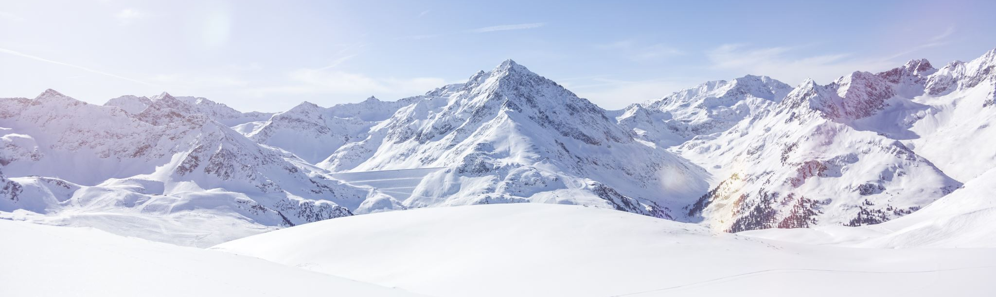
Big Mountain Resort
Ticket Pricing Model

Slide 2
Problem Identification
Big Mountain Resort is not capitalizing on its facilities as much as it could
Implement a more data-driven business strategy
Develop a new ticket pricing model
Evaluate operational changes and their impact on ticket revenue

Slide 3
Recommendation and Key Findings
Ticket Price
Big Mountain Resort should increase its Adult Weekend ticket from $81 to $95.87.
Scenarios for operational changes
Scenario 1: Permanently shut down up to 10 of the least used runs
Shutting down the least used run would have no impact on ticket revenue
Shutting down the second-least used run would reduce annual ticket revenue by approximately $710,045
Scenario 2: Increase vertical drop by 150 feet by adding a run and an additional chair lift
Expect an increase in revenue of $3,474,638
Additional chair lift operating costs estimated at $1,540,000
Expected profit of nearly $2M

Slide 4
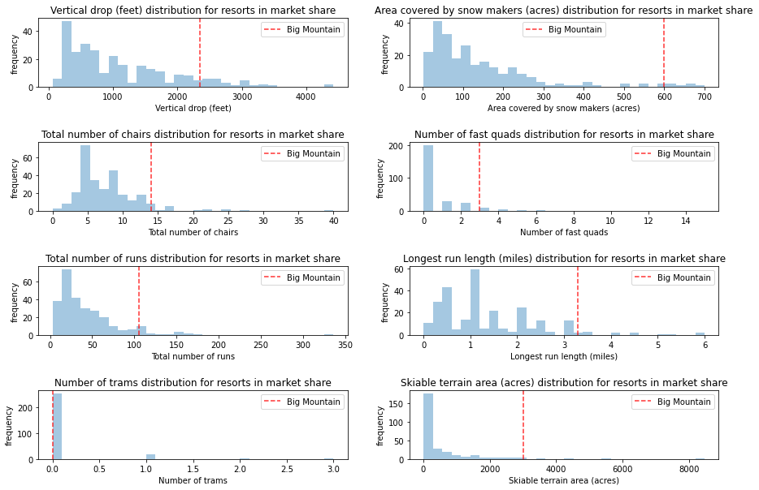
Modeling Results and Analysis
8 Key Features
Ticket pricing model using Random Forest Regression identified 8 key features that impact ticket price
Big Mountain Resort holds a strong market position in each category

Slide 5
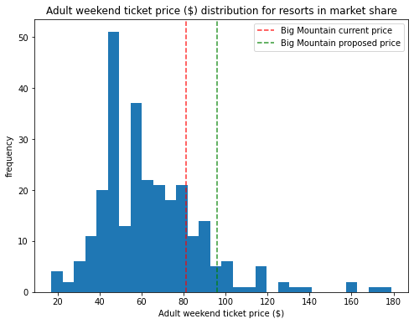
Modeling Results and Analysis
Proposed Ticket Price
Big Mountain Resort’s current Adult Weekend ticket price is $81
Ticket pricing model proposes that Big Mountain Resort’s top-notch facilities support a ticket price of $95.87

Slide 6
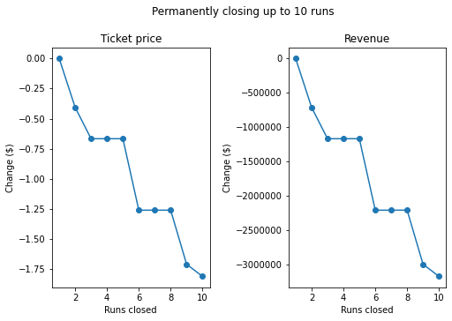
Modeling Results and Analysis
Operational Change Scenario 1
Scenario 1: Permanently shut down up to 10 of the least used runs
Permanently shut down up to 10 of the least used runs
Closing 1 run has no impact on price.
Closing 2 and 3 runs successively reduces support for ticket price and reduces estimated revenue by approximately $710,045 and $1,166,667.
The shutdown of the consecutive 4th and 5th runs results in no further loss past that assessed by the closure of the 3rd run

Slide 7
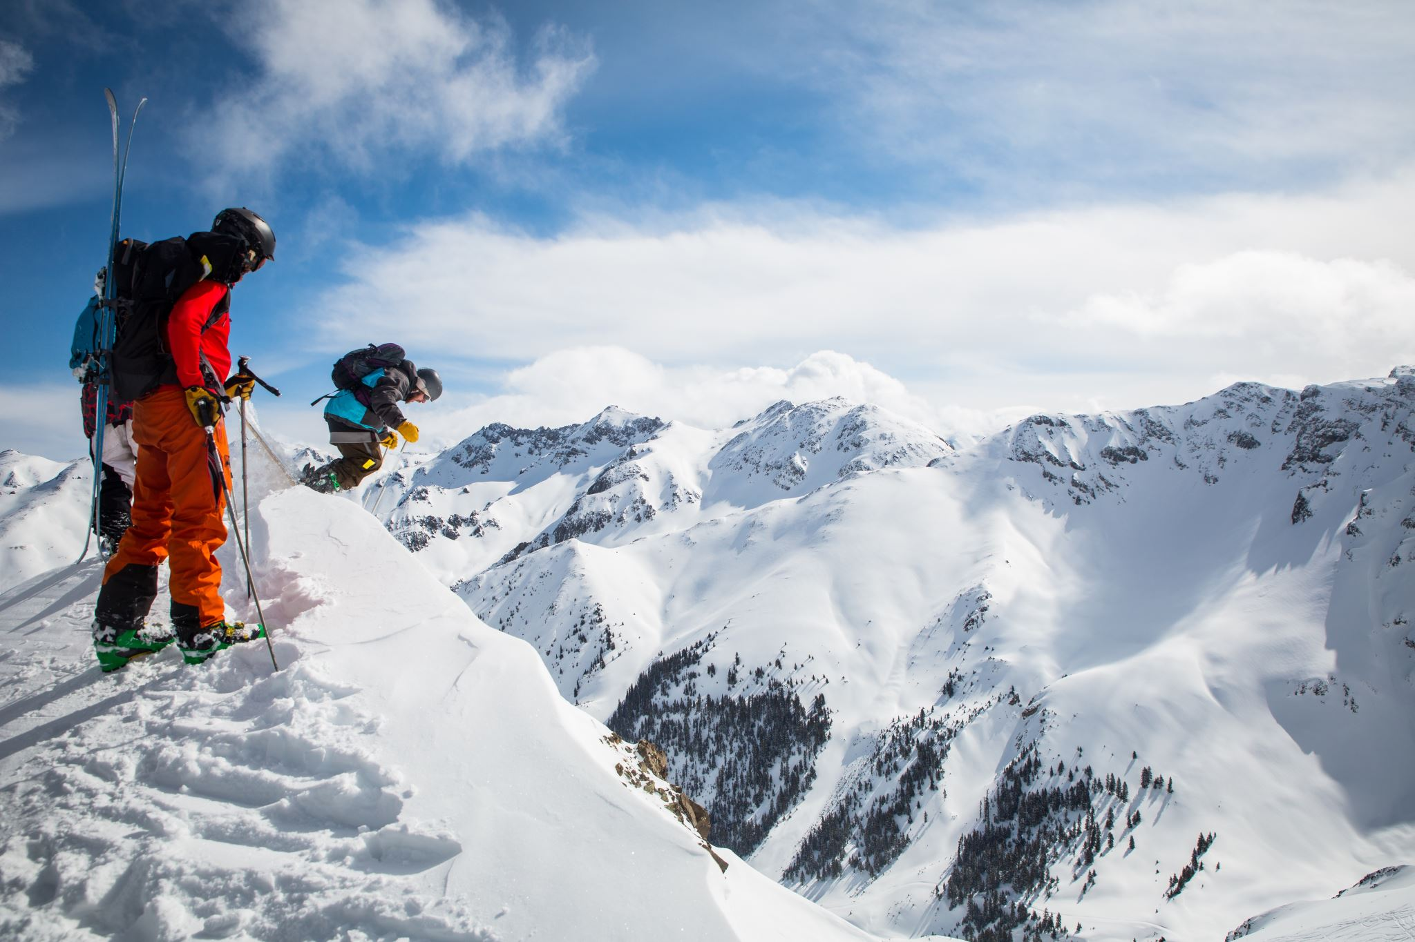
Modeling Results and Analysis
Operational Change Scenario 2
Scenario 2: Increase vertical drop by 150 feet by adding a run and an additional chair lift
Expect an increase in revenue of $3,474,638
Additional chair lift operating costs estimated at $1,540,000
Expected profit of nearly $2M

Slide 8
Summary and Conclusion
Increase Adult Weekend ticket price to $95.87
Shut down least used run
Add an additional chair lift to increase vertical drop by 150 feet

